Slide 1

UD 5
INFERENCE
1

Slide 2
INFERENCE
Part 1: Distributions in sampling
Part 2: Inference about one population
Comparison of populations
Part 3: ANOVA (Analysis of Variance)
Part 4: Regression
2

Slide 3

UD 5 part 1
Distributions
in sampling
3

Slide 4
GENERAL CONCEPTS
POPULATION
  Set of objects that we are interested in obtaining conclusions.
  Example: All pieces that are to be manufactured
  in a certain process.
SAMPLE
  Subset formed by part of objects of one population.
  Example: 10 pieces taken from the process.
sampling
sample
Population
Conclusions
(Statistical reasoning)
The sample must be “representative” of the population.
Only way to guarantee “representativity”: random sampling.
4

Slide 5
OBJECT OF SAMPLING
  To obtain precise and reliable conclusions about the population characteristics (at the minimum cost), based on the sample analysis.
STATISTICAL INFERENCE
  Process of reasoning to obtain conclusions (with a known margin of error) about the population, based on the analysis of samples taken from it.
5

Slide 6
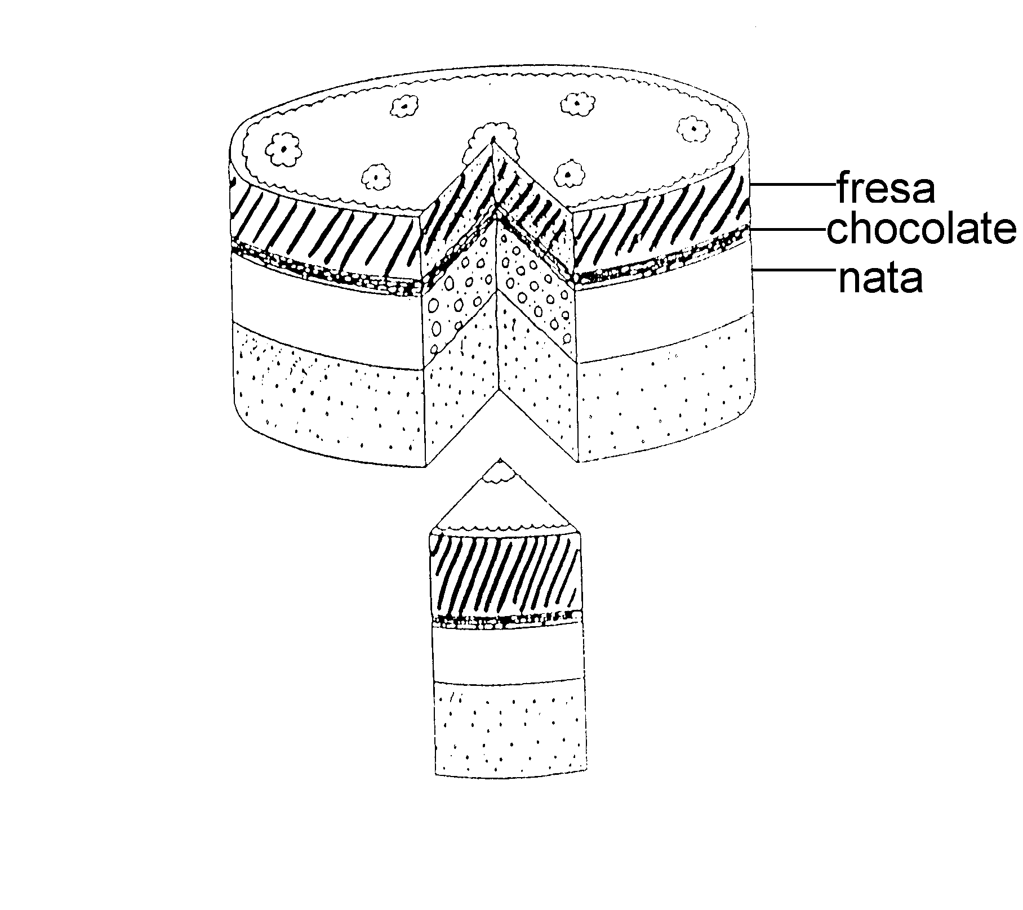
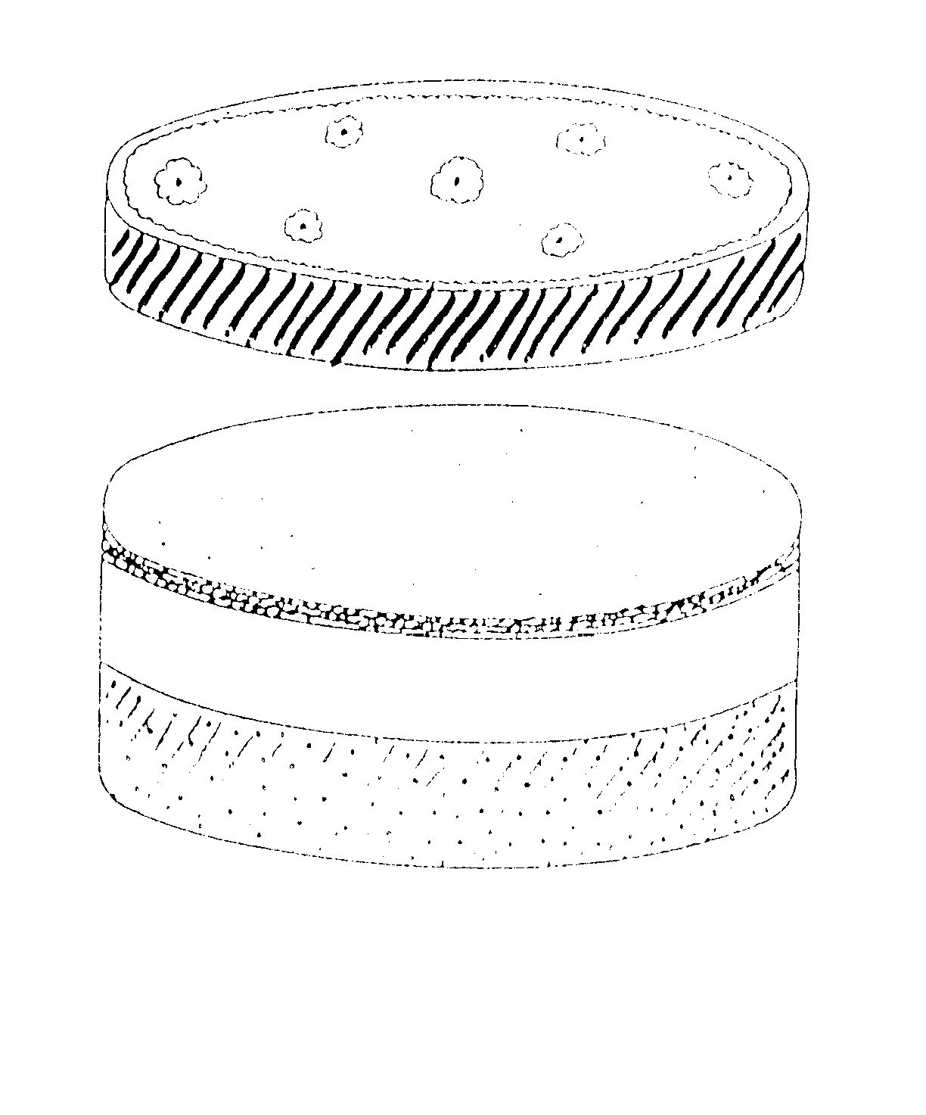

GOLDEN RULE OF SAMPLING
THE SAMPLE MUST BE REPRESENTATIVE OF THE WHOLE SET
EXAMPLE OF A VERY BAD SAMPLING
Sampling procedure to estimate TV audience share:
http://www.elmundo.es/elmundo/2011/06/12/television/1307893647.html
6

Slide 7
CHARACTERISTICS OF SAMPLING
RANDOM
Any unit of the population must have the same probability to be chosen as part of the sample.
ADEQUATE SAMPLE SIZE according to:
Size of the population under study
Variability of the evaluated characteristic
Maximum errors allowed in the estimation
EXAMPLE: How would you select 100 people for the TV program: “I have a question for you, Mr. President” ?
Difference between: Simple random sampling (s.r.s.)
stratified random sampling (e.g. social strata)
7

Slide 8
EXAMPLE:
In order to study if the manufacturing process of a certain piece works correctly, 10 pieces have been randomly taken, being the length (in mm) the following:
348.3 378.9 329.6 379.3 348.8 367.7 358.4 378.2 377.9 341.8
=
mm
The sample mean is:
x
360.89
The sample standard deviation is:
s = 18.11 mm
Can we consider that the population mean of the pieces’ length is = 350 mm, which is the nominal value ?
Can we consider that the population standard deviation of the pieces’ length is 15 mm ?
8

Slide 9

sampling
L (m, σ)
x
=
360.89
mm
s
=
18.11
mm
SAMPLE
Can we consider m = 350 mm?
Can we consider σ = 15 mm?
POPULATION OF PIECES
Depends on ...
To what extent the average ( ) and the standard deviation ( s ) of one sample can differ from the average ( m ) and the standard deviation ( σ ) of the population, respectively.
9

Slide 10
IS THE SAMPLE MEAN THE BEST ESTIMATOR OF THE POPULATION MEAN ?
N
d*
s.r.s₁
θ
POPULATION
F_{X} (x,θ)
N
C_{θ}
s.r.s₂
Possible values of θ
………
θ* = d* (x₁ … x_{N}) Estimator of θ
N
Unknown constant
s.r.s_{i}
E_{X}: POPULATION OF ALL POSSIBLE SAMPLES OF SIZE N TAKEN FROM THE POPULATION
10

Slide 11
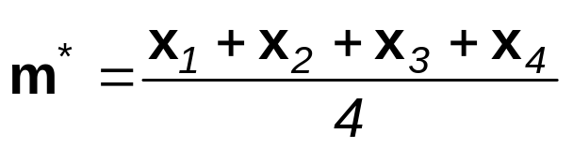
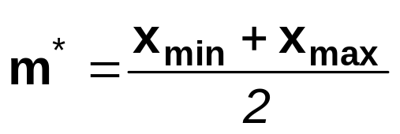
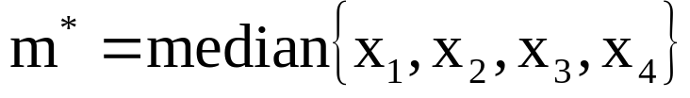
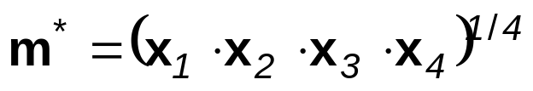
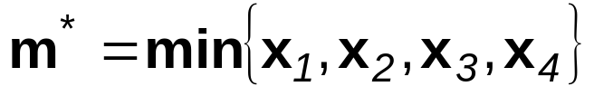
We want to know what is the average length of pieces manufactured in a certain process. For that purpose, a sample of 4 pieces is taken, and the length if each one is measured (x_{i})
What is the best estimator of the population mean, m ?
θ* (estimator of θ ) is unbiased if: E(θ*) = θ
Unbiased estimator, consistent of minimum variance
Unbiased estimators
But which of all is the “best” estimator?
Unbiased if the distrib. is Normal
unbiased?
Biased estimator: if n is high, the deviation from m increases
Bias (θ* , θ) = E(θ*) - θ
11

Slide 12
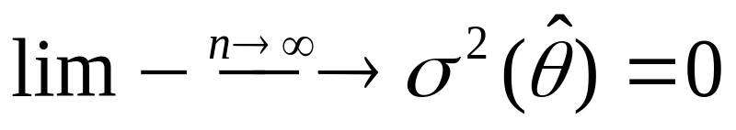
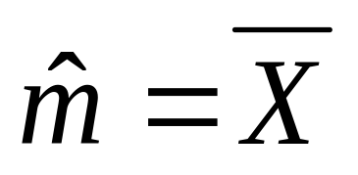
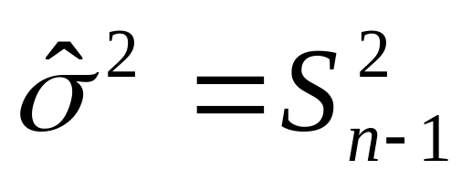
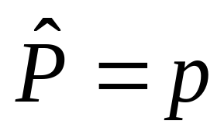
How to assess the goodness of one estimator θ* for the estimation of θ?
WHICH IS BETTER? WHY?
If θ*₁ and θ*₂
are 2 estimators of θ
θ*₂
θ*₁
θ
The best, is the estimator unbiased, of minimum variance and consistent
- the sample mean is the best estimator of m
- the sample variance is the best estimator of σ²
12

Slide 13





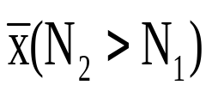


SAMPLE MEAN
X
N
s.r.s₁
m
POPULATION
X: ( m , σ² )
N
s.r.s₂
m
………
N
Unknown constants
m
s.r.s_{i}
POPULATION OF ALL POSSIBLE SAMPLES
13

Slide 14

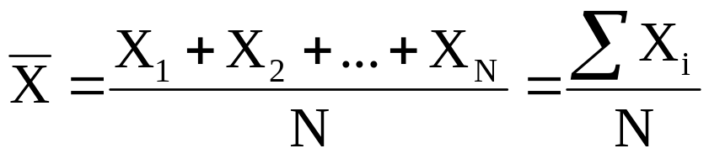
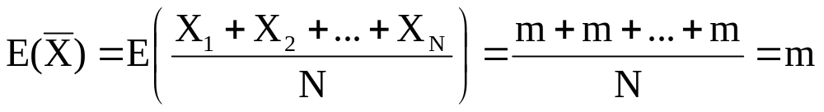
THE SAMPLE MEAN IS CALCULATED AS:
EACH ONE OF THESE X_{i} THAT CONSTITUTES THE SAMPLE, WILL BE THE OBSERVED VALUE OF A RANDOM VARIABLE WITH MEAN m AND VARIANCE σ².
THE AVERAGE OF SAMPLE MEAN IS THE POPULATION MEAN
(for any kind of distribution of X)
14

Slide 15
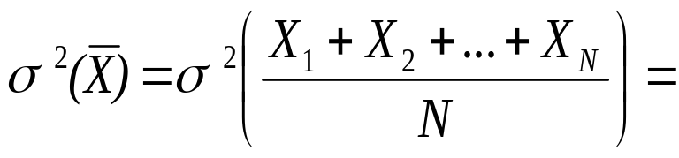
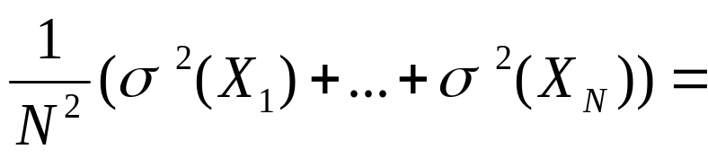
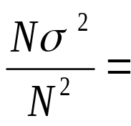
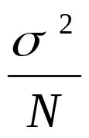

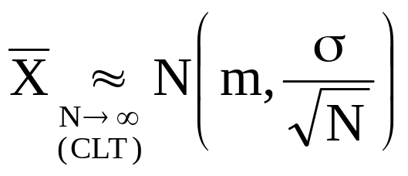
independence
THE VARIANCE OF THE SAMPLE MEAN IS THE POPULATION VARIANCE DIVIDED BY THE SAMPLE SIZE
(for any distribution)
is sum of independent random vars. with the same distribution
X
15
m

Slide 16
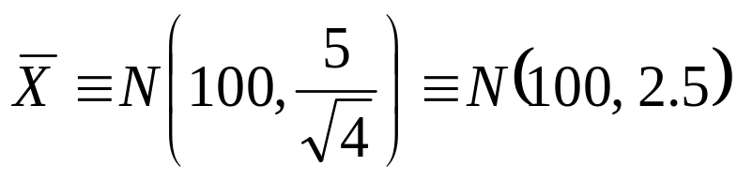
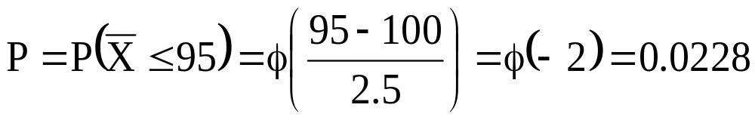
EXERCISE :
In the process of car painting, the thickness of the paint layer follows a normal distribution with average 100 μm and standard deviation 5 μm. The quality control of this process is conducted by obtaining the average of 4 measurements from 4 cars randomly selected. The process is considered as correct if the mean obtained is > 95 μm. What is the probability to reject the process?
SOLUTION:
Mean of the 4
measurements:
Probability to
reject the process:
16

Slide 17
EXERCISE :
In order to know the average expenses of Spanish families in summer holidays, N families are randomly chosen and asked about their expenses. The population standard deviation is assumed to be σ = 200 €
What should be the value N so that the difference (in absolute value) between the sample mean obtained and the unknown population mean is < 50 € with a 95% probability ?
17

Slide 18
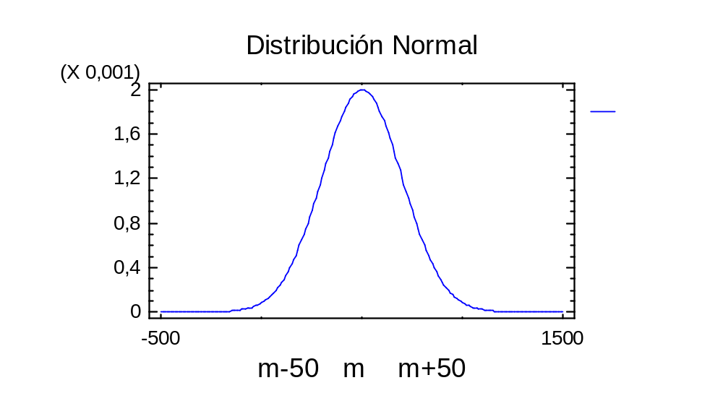

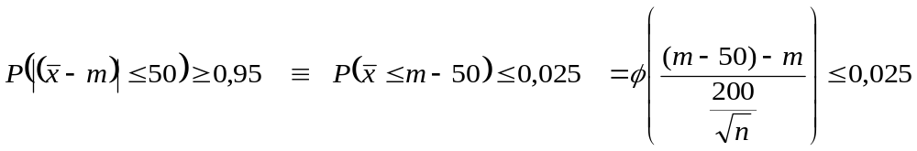
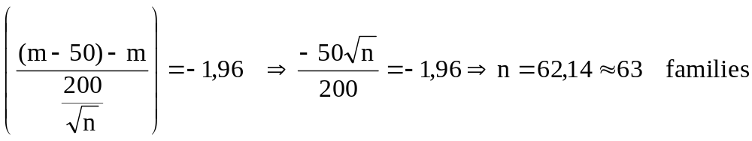
2,5%
2,5%
18

Slide 19
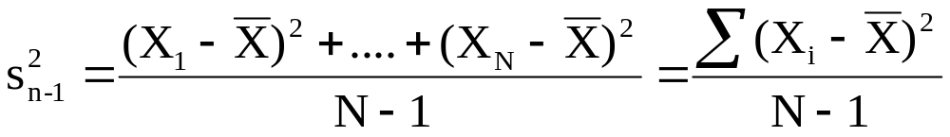
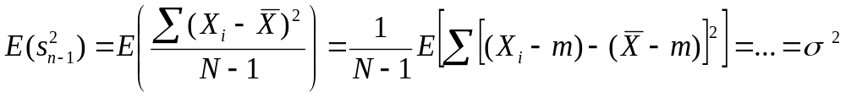
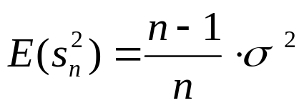
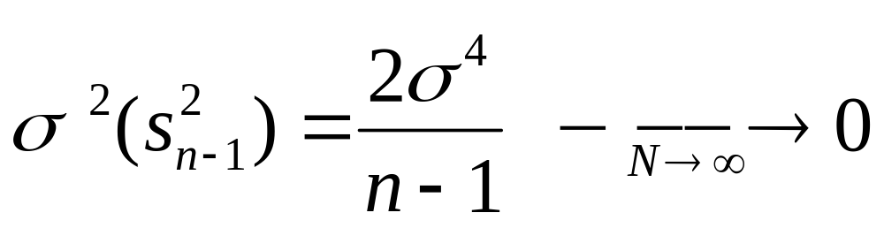
DISTRIBUTION OF s²
Unbiased estimator
Asymptotically unbiased estimator
THE AVERAGE OF THE SAMPLE VARIANCE IS THE POPULATION VARIANCE
Consistent
estimator
19

Slide 20
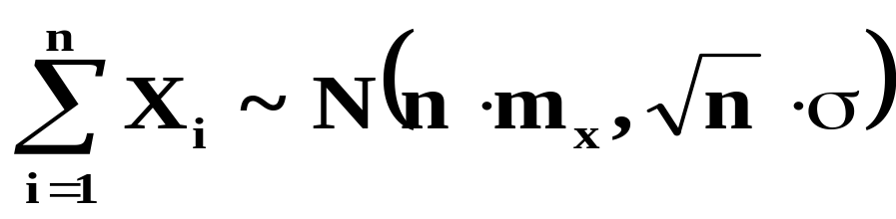
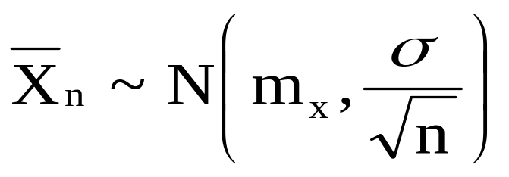
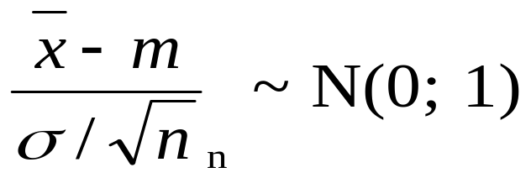
SUM OF NORMAL VARIABLES
If X₁, X₂, ....., X_{n} are random variables Normally distributed with average m_{x} and standard deviation σ equal for all of them, then:
Consequently:
(for any value n)
If X is not Normally distributed:
20

Slide 21
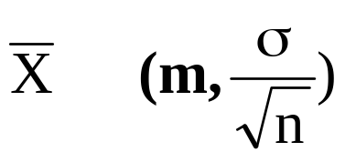
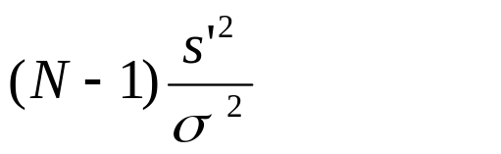
POPULATION OF ALL POSSIBLE SAMPLES
X
N
s.r.s₁
m
POPULATION
X∼ Normal( m , σ )
N
s.r.s₂
m
………
N
Unknown constants
∼N
m
s.r.s_{i}
∼χ²_{N-1}
IS ONLY TRUE IF X IS NORMAL
21

Slide 22
To study the pattern of variability of statistical parameters that appear in the sampling of normal variables,
it is necessary to know three new probability distributions:
- χ² (Pearson’s chi-square distribution)
- Student’s t
- Fisher’s F (or F of Snedecor)
IMPORTANT NOTE:
THESE DISTRIBUTIONS DO NOT MODEL THE PATTERN OF VARIABILITY OF ANY REAL VARIABLE; THEY APPEAR IN THE PROCESS OF STATISTICAL INFERENCE.
22

Slide 23
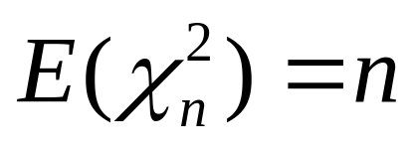
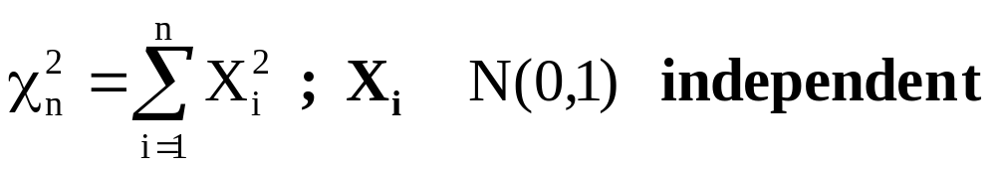
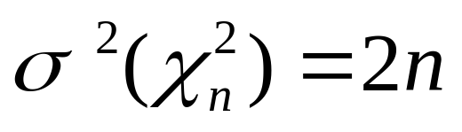
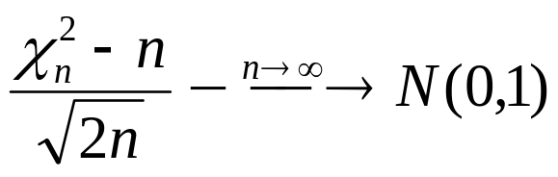
DISTRIBUTION χ²
∼
(for n>50, good approximation)
(formula table, up to n = 600)
n=5
Prob. Density Fcn.
n=10
Chi-square
n=30
0.16
0.12
0.08
prob. density
0.04
0
0
20
40
60
80
23
X

Slide 24
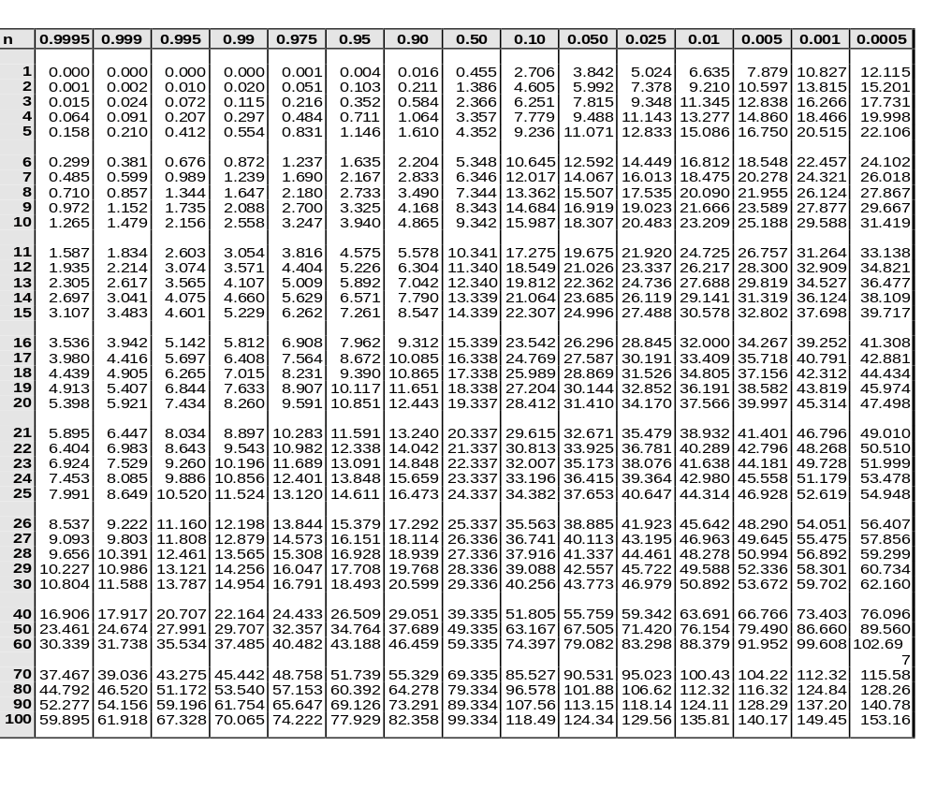
PEARSON’S χ² DISTRIBUTION
α
χ
2
n
(
α
)
24

Slide 25
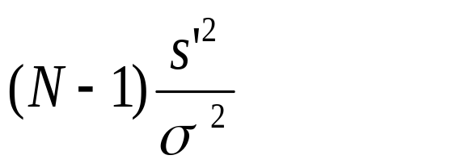
EXERCISES:
1) Demonstrate that E(χ²_{n})=n
2) Calculate the median of a χ²₅ and of a χ²₅₀
3) Justify intuitively that :
∼χ²_{N-1}
4) What is the probability to obtain a sample variance > 10 when taking a sample of size 20 from a Normal population of σ² = 5 ?
25

Slide 26
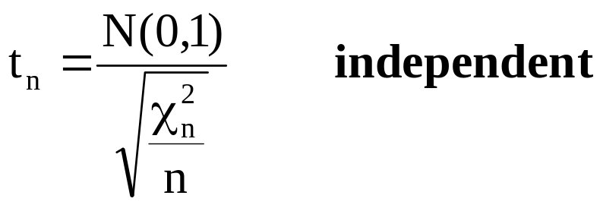
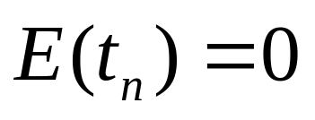
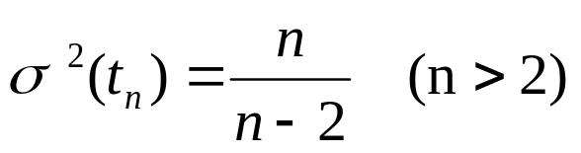
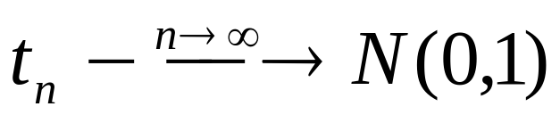
t-STUDENT DISTRIBUTION
(for n>30, good approximation)
Prob. Density Fcn.
n=5
Student's t
n=50
0.4
0.3
0.2
prob. density
0.1
0
26
-7
-4
-1
2
5
8
X

Slide 27
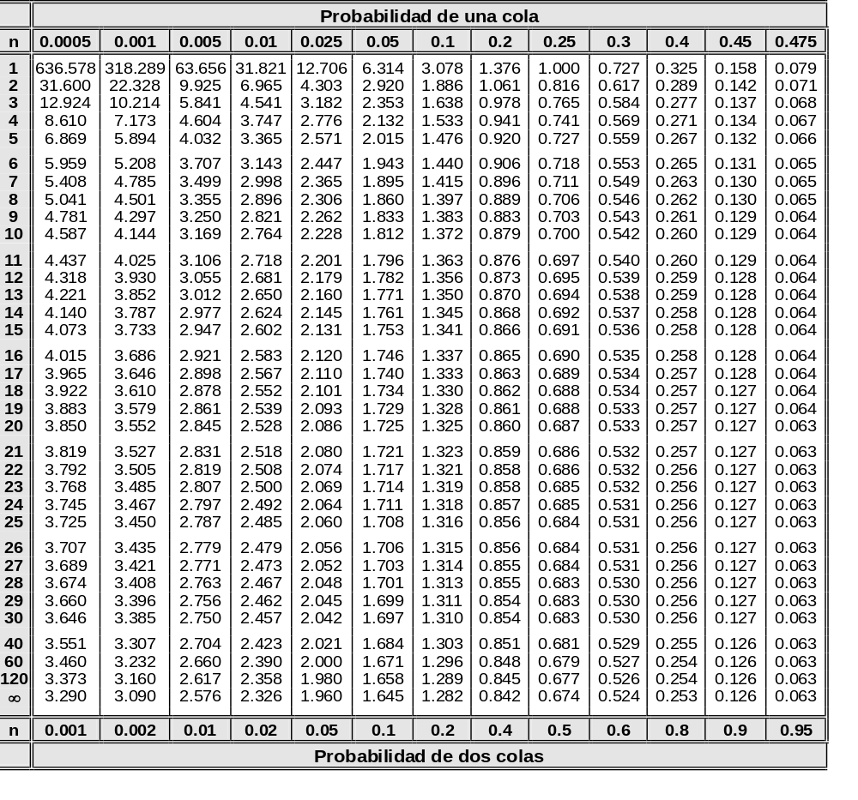
Student’s t distribution
α
)
t_{n}^{(α)}
27

Slide 28
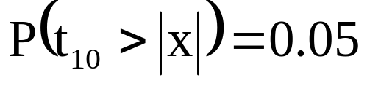

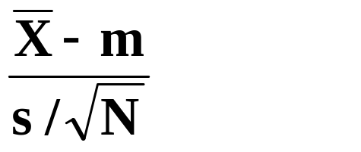
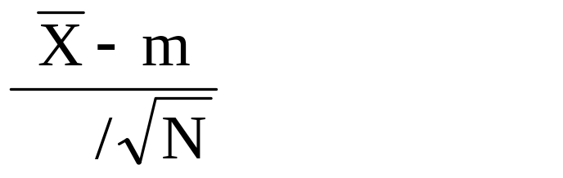
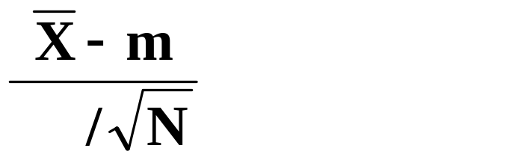
EXERCISE
Obtain a value x so that:
IMPORTANCE OF THIS DISTRIBUTION:
If and s are the mean and standard deviation of a sample with size N taken from a Normal population (m , σ) , the statistic:
^{∼ t}_{N-1}
IMPORTANT NOTE:
SEE THE ANALOGY BETWEEN:
∼ N(0,1)
σ
AND
^{∼ t}_{N-1}
s
28

Slide 29
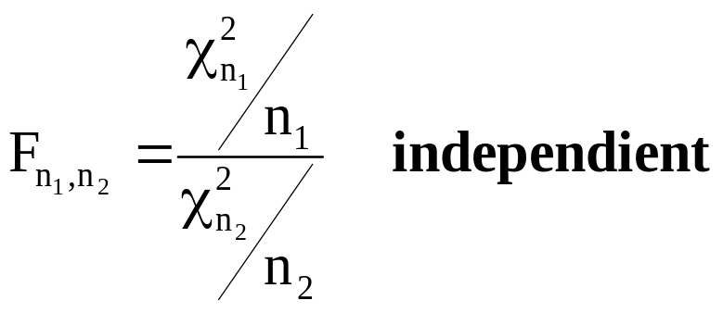
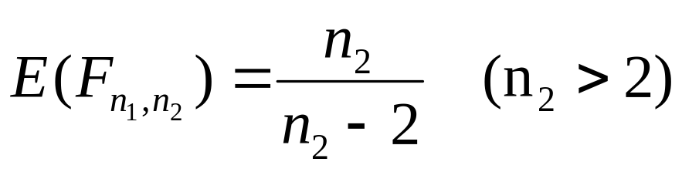

Fisher's F distribution
n₁=5 n₂=10
Prob. Density Fcn.
n₁=15 n₂=11
F
n₁=50 n₂=100
1.8
1.5
1.2
prob. density
0.9
0.6
0.3
0
0
2
4
6
X
29

Slide 30


Fisher’s F distribution
α
F
(
α
)
n
1
,
n
2

Slide 31


EXERCISE:
1) Justify intuitively that
2) Calculate a value k so that: P( F_{4,8} > k )= 0.05
IMPORTANCE OF THIS DISTRIBUTION:
To compare the variability due to different sources:
If s₁² is the variance of a sample with size N₁ extracted from a Normal population (σ₁²)
and s₂² is the variance of a sample with size N₂ extracted from a Normal population (σ₂²)
and both samples are independent:
∼
31

Slide 32
EXERCISE:
3) if two samples with size 10 are taken from the same Normal population, what is the probability to get the second sample variance double or higher than the first one?
4) We want to know if the accuracy of 2 machines filling bottles is the same. For this purpose:
- 9 bottles from machine 1 are weighted, being s₁² = 180
- 9 bottles from machine 2 are weighted, being s₂² = 250
Can we conclude that their accuracy is different?
32

Slide 33
UD 5 part 2
Inference about
one population
33

Slide 34
HYPOTHESIS TESTS
Are used to decide if certain assumptions established a priori about the population are reasonable or not.
- If the assumptions are about the parameter values of the distribution: Parametric tests
- If assumptions are about other aspects, like type of distribution, independence, etc.: nonparametric tests
Null hypothesis (H₀): the one that we want to test (usually associated to the situation considered as correct, usual or desirable).
Alternative hypothesis (H₁): the opposite to H₀ (usually associated to the situation considered as incorrect, unusual or undesirable).
34

Slide 35
HYPOTHESIS TESTS
Can we consider that the average population length of pieces is 350 mm, which is the nominal value ?
s.r.s.
POPULATION ∼ X(θ)
SAMPLE
x
=
360.89
mm
ACCEPT H₀
H₀ : θ = θ₀
m = 350
DECIDE
H₁ : θ ≠ θ₀
m ≠ 350
REJECT H₀
ACCEPT H₁
35

Slide 36
TYPES OF HYPOTHESES
SIMPLE HYPOTHESIS
H₀: m = 350
Corresponds to a single point θ = θ₀ of the parametric space C_{θ}
Assuming that this hypothesis is true, the population distribution is completely specified.
X ~ N (350,σ)
COMPOUND HYPOTHESIS
Corresponds to a region ⊂ C_{θ} , containing more than one possible value of the parameter.
This type of hypothesis does not specify completely the population distribution.
H₀: m < 350
H₁: m > 350
36

Slide 37
In this subject we will only consider the following tests:
H₀: m = 100
H₀: σ² = 5
H₀: m₁ = m₂
H₀: σ²₁ = σ²₂
H₁: m = 100
H₁: σ² = 5
H₁: m₁ = m₂
H₁: σ²₁ = σ²₂
Inference about one Normal population
Comparison of 2 Normal populations
How to study compound hypothesis tests:
H₀: m < 100
1) Test the hypothesis:
H₀: m = 100
H₁: m = 100
H₁: m > 100
2) Think with logic
E.g. x = 104 accept H₀: m=100
accept H₀: m < 100
E.g. x = 109 reject H₀: m=100
accept H₁: m > 100
E.g. x = 92 reject H₀: m=100
accept H₀: m < 100
37

Slide 38
CONSTRUCTION OF HYPOTHESIS TESTS
One statistical hypothesis tests implies establishing one partition of the sample space E_{x} (i.e. the set of all samples than can be obtained) in two regions:
- Region R of rejection: if the sample (x₁ , x₂ , … , x_{n}) ∈ R, the null hypothesis H₀ is rejected.
- Region A of acceptance: if the sample (x₁ , x₂ , … , x_{n}) ∈ A the null hypothesis H₀ is accepted.
being A the complementary region of R in the sample space E_{X}
Accept H₀
A
R
Reject H₀
C_{d}: set of possible decisions
E_{X} : SAMPLE SPACE
38

Slide 39
One hypothesis test is determined by:
- Sample size
E.g.: n = 5
- Sample type
E.g.: simple random sampling
- Statistical parameter θ* used
E.g.: x
- Region of acceptance / rejection
E.g.: if x € [ 2.8, 3.2 ] accept H₀: m=3
How would we test the following hypothesis?
Is there a relationship X - Y or are they independent ?
96
Y
Y = a + b·X
86
76
H₀: b = 0
66
H₁: b = 0
56
39
150
155
160
165
170
175
180
X

Slide 40
TYPE I, TYPE II ERRORS
When conducting a hypothesis TEST, there are two possible erroneous decisions that can be made, called:
- Type I error: To reject H₀ when it is true
(error of the 1st kind, α error, false positive).
- Type II error: To accept H₀ when it is false (being true H₁)
(error of the 2nd kind, β error, false negative).
Definitions:
- Type I risk ( α ): probability to make a type I error
(significance level of the test)
- Type II risk ( β ): probability to make a type II error.
1-α = confidence level
1-β = power of the test
Observed significance level: p-value (probability of having obtained a computed statistical parameter more unfavorable, being true H₀)
40

Slide 41
EXERCISE
Random var. X: No. of defects in one piece
X ~ Ps (λ)
λ = Average number of defects in one piece
From a sample of size 10, we want to test the null hypothesis that the parameter λ of a Poisson distribution is 2 versus the alternative that is > 2. We will accept H₀ if the sample mean is ≤ 2.5 and will reject H₀ otherwise.
A) What is the type I risk of this test ?
B) What is the type II risk if λ actually is 3 ?
C) What is the type II risk if λ actually is 4 ?
41

Slide 42
INFERENCE ABOUT
ONE NORMAL POPULATION
s.r.s.
SAMPLE
x = 1993.6
¿m=2000? or ¿m≠2000?
INFERENCE
¿ m ? ¿ σ ?
POPULATION
42

Slide 43
EXAMPLE:
One machine that fills 2-liter soft drink bottles is adjusted to fill in average 2000 ml. In order to control its performance, a sample of 15 bottles is randomly taken, resulting the following data (ml filled):
1989 2015 1962 2013 1983 1989 1992 2011 1958 2023 1980 1977 1994 2017 2001
1) Estimate from the sample, the mean m and the standard deviation σ of the population under study.
2) Is there enough evidence to say that m differs significantly from 2000 and that, consequently, the machine should be readjusted?
3) Between what limits is comprised the value of m, with a reasonable confidence?
4) Between what limits is comprised the value of σ, with a reasonable confidence?
43

Slide 44
STEPS IN THE INFERENCE ABOUT
A NORMAL POPULATION
1) Descriptive analysis of the sample (parameters of position and dispersion).
2) Normality of the data and detection of outliers (Histograms, Normal Probability Plot).
3) Hypothesis test: m=2000 (Student’s t test).
4) Confidence interval for m (Student’s t).
5) Confidence interval for σ (Chi²).
6) Analysis with Statgraphics (Describe ⇒ Numeric Data ⇒ One-Variable Analysis).
44

Slide 45



1) DESCRIPTIVE ANALYSIS OF THE SAMPLE:
Variable: Volume
Since = 1993.6 which is
different from 2000, should we
readjust the machine?
-------------------------------
Sample
size 15
Average 1993.6
Median 1992
Mode 1989
NOT NECESSARILY !
Geometric
mean 1993.51
Variance 391.971
Standard
deviation 19.7983
The difference between and
2000 can be by chance
(due to the random sampling)
Standard error 5.11189
Minimum 1958
Maximum 2023
Range 65
Lower
quartile 1980
Upper
quartile 2013
Actually, will never be exactly 2000
Interquartile
range 33
Skewness -0.256502
Standardized
skewness -0.405564 ∈(-2,2)=> CA=0
Kurtosis (CC-3) -0.750953
Standardized
kurtosis -0.593681 ∈(-2,2)=> CC=3
---------------------------------------
45

Slide 46
2) NORMALITY OF DATA:
Most techniques of statistical inference for continuous variables assume that sampled populations are Normal.
How can we check if this previous hypothesis is acceptable in our case?
3 ways:
- To use formal statistical tests (they require many data in general. Not very useful in practice).
- To plot a Histogram (requires at least 40-50 data).
- To plot data on a Normal Probability Plot.
It is also convenient to check the values of the skewness and kurtosis coefficients.
46

Slide 47
CAN THE DATA BE REGARDED AS NORMAL?
Normal Probability Plot
99.9
99
95
cumulative percent
80
50
20
5
1
0.1
1950
1970
1990
2010
2030
FILLED VOLUME
NO OUTLIERS ARE OBSERVED
47

Slide 48

3) HYPOTHESIS TEST m=2000:
It is called Null Hypothesis because it reflects the previous knowledge of the situation (the machine should fill in average 2000 ml)
Intuitive reasoning: if m=2000 (H₀ true), will be “similar” to 2000 and, hence, ( - 2000) will be similar to zero. Consequently:
- If ( - 2000) “is similar” to zero, H₀ will be accepted
(and the machine will not be readjusted).
- If ( - 2000) is “quite different” from zero, H₀ will be rejected: it will be admitted that m differs from 2000 (and the machine will be readjusted).
But … what should we consider as “being similar” ?
The “distance” in statistics has to be measured taking into account the variability:
48

Slide 49







H₀ : m = 2000
H₁ : m ≠ 2000
We know that
If H₀ is true (m=2000)
In tables we obtain:
α / 2 = 0.025
If H₀ is true:
Value obtained
α / 2 = 0.025
If H₀ is false:
-1.25
-2.14
0
2.14
Reject H₀
Accept H₀
Reject H₀
Thus, if:
> 2.14 Reject H₀
≤ 2.14 Accept H₀
Conclusion: the hypothesis m=2000 is acceptable !
(there is not enough evidence to reject H₀)
49

Slide 50




H₀ : m = m₀
SUMMARY OF THE TEST:
H₁ : m ≠ m₀
If
Reject H₀
critical value
If
Accept H₀
Being a value in Student’s t table so that:
If σ is known: use the N(0; 1) table (last row in t table)
If H₀ is accepted it does not imply that it is necessarily true, it is just that we don’t have enough evidence to reject it.
50

Slide 51



If σ is known:
When H₀ is true, we select a region where it is quite likely (probability 1-α) to find that statistical parameter. This is the test acceptance region, and the complementary, the critical region.
1-α
rejection zone acceptance zone rejection zone
m₀
being z_{α/2} the critical value of N(0;1)
51

Slide 52

Although in fact m≠m₀ we will still accept H₀ because the sample mean falls in the acceptance region with a probability β₁ (probability of type II error for m=m₁≠m₀)
β₁ for m=m₁
β: usually unknown
rejection zone acceptance zone rejection zone
m₁
α should be low, but if α decreases, β increases (and vice versa)
In order to decrease α and β we should increase the sample size (having more information about the population allows us to reduce the probability of choosing the wrong decision).
α : usually set at 0.05 or 0.01 (never, α > 0.1)
52

Slide 53



4) CONFIDENCE INTERVAL FOR m:
Is it possible, from the sample, to calculate an interval containing with a high probability (1-α) the unknown value m of the population mean?
Since:
∼
Therefore:
This confidence interval has a probability ( 1-α ) of containing m.
1-α: confidence level
If σ is known: use z_{α/2} instead of t_{α/2}
53

Slide 54

EXAMPLE:
1982.7
2004.5
CONFIDENCE INTERVAL FOR m (95%) (1982.7 , 2004.5)
QUESTION:
What practical interpretation has this probability 1-α associated to a certain confidence interval?
srs₁
( )
m
( 1-α ) ·100 (%) WILL CONTAIN m
srs₂
( )
m
…..
srs_{i}
( )
m
α ·100 (%) will NOT contain m
srs_{i+1}
( )
m
What kind of interval can we assume in this case for the computed interval (1982.7 , 2004.5)?
54

Slide 55
HYPOTHESIS TEST for m USING
CONFIDENCE INTERVALS:
H₀ : m = m₀
H₁ : m ≠ m₀
If m₀ ∈ Confidence Interval
Accept H₀
If m₀ ∉ C.I.
Reject H₀
Accept H₁
m₀=1990
m₀=2000
m₀=2003
( )
1982.7
2004.5
Do not readjust the machine
Accept H₀
Is reasonable that m=2000
Readjust the machine because fills <2000
Is reasonable that m=1990
Is reasonable that m=2003
Readjust the machine because fills >2000
Have we demonstrated that m=2000 ?
The confidence interval contains all null hypotheses consistent with the obtained sample
55

Slide 56

P-VALUE (OBSERVED SIGNIFICANCE LEVEL)
For this test: p-value:
t₁₄
If p-value < α : reject H₀
If p-value > α : accept H₀
p-value/2
p-value/2
α / 2 = 0.025
α / 2 = 0.025
-1.25
For other tests, p-value
is calculated differently
but this rule is always true.
-2.14
0
2.14
Reject H₀
Reject H₀
t_{calc}
p-value: probability of having obtained a computed statistical parameter more unfavorable, being true H₀
56

Slide 57








5) CONFIDENCE INTERVAL FOR σ²:
We know that:
∼
In the χ² table it is possible to find two values g₁, g₂ so that:
α / 2
α / 2
(1)
1-α
For example: P(5.63< χ²₁₄<26.1)=1-0.05 = 0.95
g₁
g₂
From (1) we obtain:
Therefore:
In this example:
[ 14.5 , 31.2 ] is a confidence interval for σ
57

Slide 58
6) ANALYSIS WITH STATGRAPHICS
OPTION: “ONE-VARIABLE ANALYSIS”
Hypothesis Tests for VOLUME
Sample mean = 1993.6 Sample median = 1992.0
t-test
Null hypothesis: mean = 2000
Alternative: not equal
Computed t statistic = -1.25198
P-Value = 0.231089
Do not reject the null hypothesis for alpha =0.05
Confidence Intervals for VOLUME
95% confidence interval for mean:
1993.6 +/- 10.9639 [1982.64; 2004.56]
95% confidence interval for standard deviation: [14.4948; 31.2238]
58

Slide 59


COMPARISON OF 2
NORMAL POPULATIONS
59

Slide 60

Two computer programs (A, B) are available to search files in a hard disk. In order to determine which one works faster, 10 files are searched with each program, and the time required to find the each file is recorded.
OBJECT OF THE STUDY, to compare two populations:
- Files to be searched by program A
- Files to be searched by program B
10 with program A
20 trials are conducted:
10 with program B
What is measured in each experimental trial?
RESULTS:
s
prog. A.
3.4
3.7
2.9
2.5
1.6
2.8
3.7
5.9
4.8
4.3
3.56
1.23
prog. B
2.7
3.2
1.8
1.9
1.1
2.2
2.8
4.8
4.3
3.4
2.82
1.15
HOW SHOULD THESE DATA BE STATISTICALLY ANALYZED ?
60

Slide 61




FUNDAMENTALS OF THE STATISTICAL ANALYSIS:
2 Populations studied: files in the hard disk that can be searched by program A or B.
Random variable: time required to search a file.
It is assumed that the variable is normally distributed:
m₁
σ₁
m₂
σ₂
Sampling:
X₁ , X₂ , … , X₁₀
X₁ , X₂ , … , X₁₀
Statistical parameters calculated from the samples:
>
>
¿ m₁ = m₂ ?
¿ σ₁ = σ₂ ?
<
<
61

Slide 62

COMPARISON OF VARIANCES
H₀ : σ₁² = σ₂²
H₁ : σ₁² ≠ σ₂²
If the null hypothesis is true:
- s₁² will be “similar” to s₂²
- The ratio s₁² / s₂² will be similar to 1. The null hypothesis will be rejected if this ratio is clearly different to 1.
But...
what should be considered as being “similar” or not?
If H₀ is true:
∼
STEPS:
1) If s₁ > s₂: divide s²₁ / s²₂. If s₂ > s₁: divide s²₂ / s²₁
2) Test if the obtained ratio is “too high” to be a F_{n1-1,n2-1}
ALTERNATIVE PROCEDURE:
1) Obtain a confidence interval for σ²₁/ σ²₂ (see formula)
2) if 1 belongs to this interval: accept H₀
62

Slide 63


EXAMPLE:
P ( F_{9,9} > f ) = 0.05
f = 3.18
IF THE NULL HYPOTHESIS IS TRUE:
σ₁² = σ₂²
F_{9,9}
∼
5%
SINCE F_{9,9}(5%) = 3.18 > 1.14
1.14
3.18
THE NULL HYPOTHESIS IS ACCEPTED
obtained value
critical value at 5%
THERE IS NOT ENOUGH EVIDENCE TO AFFIRM THAT THE VARIANCE OF TIME TO SEARCH A FILE WITH PROGRAMS A or B IS DIFFERENT.
If σ₁² ≠ σ₂² the subsequent test for mean comparison is approximate, though it is quite “robust” if the number of observations in both samples is similar.
63

Slide 64







COMPARISON OF MEANS
H₀ : m₁ = m₂
H₁ : m₁ ≠ m₂
If H₀ is true:
- will be “similar” to
- will be “similar” to zero.
What should be considered as “being similar”?
We know that:
∼
(considering that σ₁² = σ₂²)
If m₁ = m₂ :
∼
If N₁ = N₂ :
64

Slide 65



EXAMPLE:
t₁₈
α / 2 = 0.025
Value obtained
α / 2 = 0.025
1.39
-2.101
0
2.101
RESULTS ARE CONSISTENT WITH THE HYPOTHESIS m₁=m₂
And since t₁₈(5%)=2.101 > 1.39
65

Slide 66

CONFIDENCE INTERVAL FOR m₁-m₂
Alternative equivalent way (though more informative) of analyzing the results of this experiment:
Interval for m₁-m₂ with a confidence level (1-α) x 100 :
In the example:
being 2.101 = t₁₈(2.5%) from the t-table.
( )
-0.37
0
1.85
We can affirm with quite confidence (95% of confidence) that the difference m₁-m₂ is comprised between -0.37 and 1.85
66

Slide 67
ANALYSIS OF RESIDUALS
General definition:
Residual= value observed - value estimated by a model
Residual is the part of the observed value due to the variability caused by factors not controlled in the experiment.
residual = value observed ─ value estimated
AVERAGE
EXAMPLE:
First observation from program A:
residual = 3.4 ─ 3.56 = -0.16
67

Slide 68
UTILITY OF RESIDUALS ANALYSIS
(GRAPHICAL METHODS)
NORMAL PROBABILITY PLOT
OF RESIDUALS :
* CHECK FOR NORMALITY
* DETECTION OF OUTLIERS
Normal Probability Plot
99.9
99
95
The average
of all residuals
is zero
80
cumulative percent
50
20
5
1
0.1
-2
-1
0
1
2
3
68
RESIDUALS

Slide 69
Differences statistically significant ≠ differences important
The average is statistically
different from 100
There is enough evidence to say that...
- the population average is not 100.
The difference between
both sample means is
statistically significant
- the population means are different.
Doing N high enough, we can detect as significant ANY difference of means, though in practice they might be irrelevant.
Actually, if n→∞ we are comparing the whole populations.
69

Slide 70
ANALYSIS WITH STATGRAPHICS:
COMPARE => 2 SAMPLES => TWO-SAMPLE COMPARISON
Comparison of Means
95,0% confidence interval for mean of time_A: 3,56 +/- 0,8795
95,0% confidence interval for mean of time_B: 2,82 +/- 0,82036
95,0% confidence interval for the difference between the means
assuming equal variances: 0,74 +/- 1,117 [-0,377,1,857]
t test to compare means:
Null hyp.: mean1 = mean2 Alt. hypothesis: mean1 NE mean2
assuming equal variances: t = 1,39186 P-value = 0,180927
Comparison of Standard Deviations
Variance time_A: 1,51156 Variance time_B: 1,31511
Ratio of Variances = 1,14937
95,0% Confidence Intervals
Ratio of Variances: [0,285488; 4,62738]
F-test to Compare Standard Deviations:
H0: sigma1 = sigma2 Alt. hypothesis: sigma1 NE sigma2
F = 1,14937 P-value = 0,839105
70

Slide 71
Conclusion of the test: accept m_{A} = m_{B} BUT...
For all trials: time_{A} > time_{B}
prog. A.
3.4
3.7
2.9
2.5
1.6
2.8
3.7
5.9
4.8
4.3
prog. B
2.7
3.2
1.8
1.9
1.1
2.2
2.8
4.8
4.3
3.4
Lowest value from A and B:
Highest value from A and B:
Is it a coincidence?
For some reason this file was more difficult to be found by both programs
In this case (one two-dimensional variable), better to apply another test
STATGRAPHICS:
Compare => 2 samples => Two-sample comparison
Compare => 2 samples => Paired-sample comparison
To compare the population mean of two characteristics measured in the same individuals, a paired-sample comparison is more powerful than a two-sample comparison.
71
With a paired-sample test: reject H₀: m_{A} > m_{B} (makes sense!)

